Slide 1
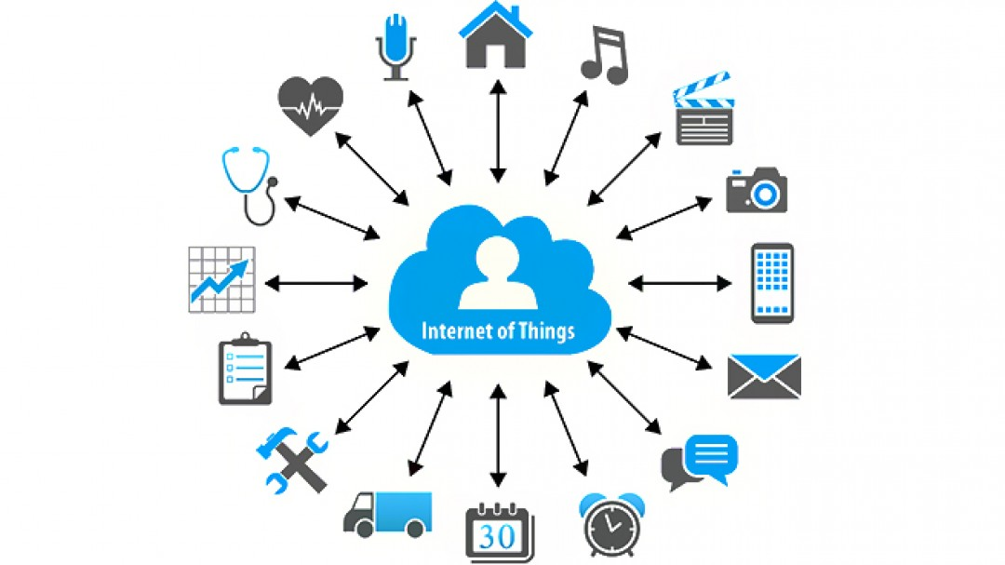
For Discussion
Canadian Multistakeholder Process - Enhancing IOT Security:
Consumer Empowerment through Education
September 2018

Slide 2
Introduction
On August 15th, the Consumer Education & Awareness WG agreed at its first virtual meeting to start working on drafting key messages that the initiative could endorse as key components to make an effective education or outreach program.
Key messages are to be grouped within three categories - privacy, security, functionality¹; and across three verticals - before purchasing, after purchased, at problem.
These messages will then be assessed to ensure they address the devices and audiences most vulnerable to IOT privacy and security risks, while still encouraging IOT adoption.
Preliminary views are to limit the scope of messages to household and business devices as a starting point for this WG (instead of AVs or SCs).
The objectives of this meeting is to: 1) leverage expertise to identify messages and gaps; and 2) provide an initial assessment and consolidation of the list of draft messages.
Notes:
1. Technological Protection Measures (TPM): contracts and copyrights (i.e. Digital Rights Management (DRM), restrictions on resale, repair and interoperability)

Slide 3
Draft IOT Consumers Education & Awareness Framework
 | Categories | Stages
 |  | Before Purchasing | After Purchasing | At Problem
Potential themes for Key Messages | Privacy | Read privacy information before purchasing. Understand meaningful consent. Check whether it is possible to not provide some information and still use the product as intended. | Learn about the privacy settings in your browser and keep it up to date. Let the manufacturer know if you are not comfortable with your information being shared. Remove all your personal information Before disposing of your connected device. | OPC
 | Security | What are the security measures put in place by the company? (i.e. will communications between the connected device and my phone be encrypted? Investigate the level of security provided with the IOT device. Ask about the availability and duration of security upgrades and patches, etc. | Create a guest WiFi network just for IOT devices to keep them separate from your computers and other more secure devices. Ensure the network is password protected — and choose WAP2 when prompted. Change the default password on the device. Make sure your passwords are strong and don’t re-use the same password across multiple devices or services. Ensure your home network is secured, for example, with virus protection and firewalls. update the computer program that runs the device (known as the firmware) if you receive a notification do to so. | _
 | Functionality | Copyrights: Are there TPMs on the software that will limit how the consumer can use the device, e.g. limit their ability to tinker with it or to ensure interoperability? Will software updates be available free of charge? Are there restrictions on consumers’ ability to use services of a third party to repair the device? Is the software part of a closed ecosystem that will not function with the software in other IOT devices? Contracts: What are the policies with respect to returns, refunds and exchanges? Does the device/software come with a manufactures warranty? If so, for how long? Does the warranty cover software? Does the company offer post-sale customer support? Is the IOT product functional without internet connectivity? | _ | Provinces

Slide 4
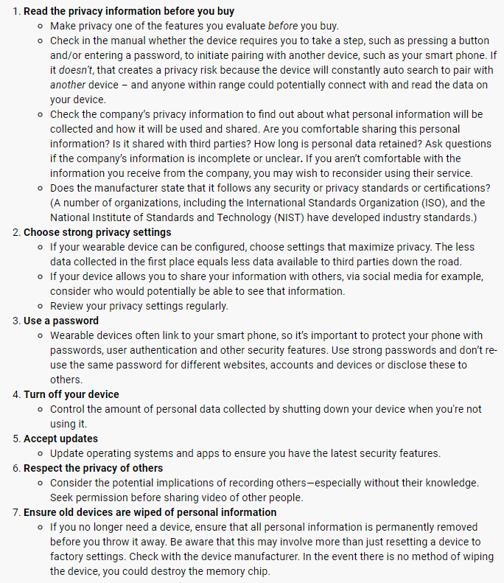
OPC
Tips to Protect Privacy
Sources:
https://www.priv.gc.ca/en/privacy-topics/technology-and-privacy/digital-devices/02_05_d_73_wd/
https://www.priv.gc.ca/en/privacy-topics/technology-and-privacy/02_05_d_72_iot/

Slide 5
PSC
Cyber Safe Toolkit
Sources:
https://www.getcybersafe.gc.ca/cnt/rsrcs/pblctns/cbrsf-tlkt/index-en.aspx

Slide 6
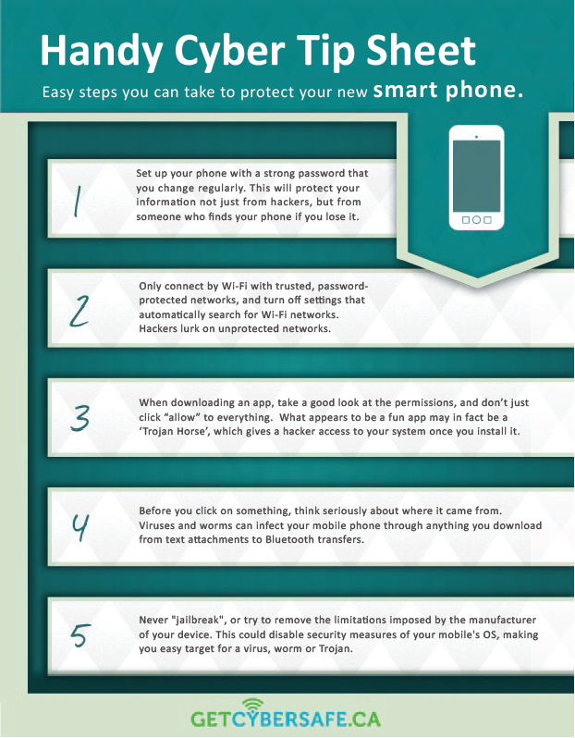
PSC
Cyber Safe Tip Sheet
Sources:
https://www.getcybersafe.gc.ca/cnt/rsrcs/pblctns/cbrsf-tlkt/index-en.aspx

Slide 7
Considerations
Discussions on these issues are still ongoing (e.g., via ISED Digital and Data Consultations) and key stakeholders such as provinces will need to weigh in.
There is some overlap with respect to consumer issues that are raised via copyright policy versus contract law. Most of the issues raised in the copyright one-pager (e.g. TPMs limiting functionality of device; availability and cost of software upgrades; restrictions on ability of consumer’s to use a third party to repair the device) are also relevant to contact law.
Notes:
1. Technological Protection Measures (TPM): contracts and copyrights (i.e. Digital Rights Management (DRM), restrictions on resale, repair and interoperability)

Slide 8
Participation & Questions Welcome!

